Slide 1
Using assessment to drive the development of teaching-learning sequences
Robin Millar
ESERA Conference, Helsinki, September 2015

Slide 2
Overview
Development & Research (D&R) project for lower secondary school science (age 11-14)
  York Science
Some general comments about the role of assessment
Brief overview of project
Outline the development process
Show some examples of resources (if time)
Overview of teachers’ responses and impact

Slide 3
The role of assessment in teaching & learning
– and in planning and design

Slide 4
Influences on the classroom
Curriculum
(what we want to teach)
Pedagogy
(how we teach)
Assessment
(how we find out what students have learned)

Slide 5
Influences on the classroom
Assessment
(what we want students to be able to do)
Curriculum
(what we therefore need to teach them)
Pedagogy
(how we teach this)

Slide 6
The purposes of assessment
Summative
  To measure students’ attainment at a specific point in time (e.g. the end of a year, or term, or course), in a form that can be reported to others
Formative
  To collect evidence of students’ learning and use it to guide and encourage the subsequent actions of learners and teachers
Diagnostic
  To identify students with specific misconceptions or learning difficulties (so closely related to formative)
Accountability
  To provide evidence of the effectiveness of teachers, schools, and education systems

Slide 7
A more fundamental purpose
Assessment clarifies the intended learning objectives of a lesson, or programme, or course.
“… by its very nature assessment reduces ambiguity. The fifth-grade mathematics standard for many states requires students to be able to compare two fractions to find the larger, but when we assess, we have to decide which pairs of fractions should be included and which should not.
… In fact, the choice of the fractions to be compared makes a huge difference to the rate of student success” (p. 254)
(From: Wiliam, D. (2010). What counts as evidence of educational achievement? The role of constructs in the pursuit of equity in assessment. Review of Research in Education, 34, 254-284.)

Slide 8
Considering assessment last doesn’t work
Science investigations (in the English National Curriculum from 1989)
Nature of Science
  ‘How Science Works’ in the English National Curriculum and A-level criteria from 2006
‘Ideas about Science’ in the Twenty-First Century Science project (Millar, 2006, 2013)

Slide 9
Curriculum development – putting assessment first

Slide 10
York Science: Aim
To develop and evaluate teaching resources for lower secondary school science (students 11-14)
that help teachers to improve the quality of student learning
  by keeping clear learning outcomes in mind when planning instruction
  by monitoring students’ learning during the teaching-learning process in time to act on what they find (embedded formative assessment)

Slide 11
York Science: Context
Many students’ aspirations and choices and formed during the early years of secondary schooling (e.g. Archer et al., 2013)
Successive revisions of the English National Curriculum are widely seen to have led to a loss of curriculum coherence and clarity of purpose, especially at this age (Oates, 2010)
New regulations are about to be introduced: teachers are concerned about how to respond to these

Slide 12
York Science: Theoretical rationale
Why focus on assessment?
Research studies (e.g. Black & Wiliam, 1998; Hattie, 2009) provide strong evidence that the formative use of assessment leads to improved student learning

Slide 13
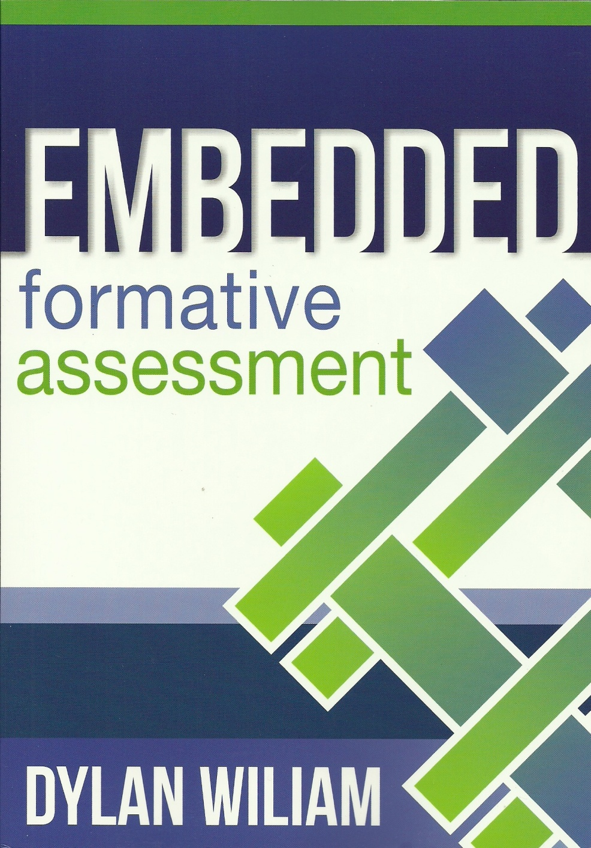
Asking good questions is crucial
“sharing high quality questions may be the most significant thing we can do to improve the quality of student learning.” (p. 104)
Wiliam, D. (2011).
Embedded formative assessment.
Bloomington, IN: Solution Tree Press.

Slide 14
York Science: Theoretical rationale
Why focus on assessment?
Research studies (e.g. Black & Wiliam, 1998; Hattie, 2009) provide strong evidence that the formative use of assessment leads to improved student learning
The idea of ‘backward design’ (Wiggins & McTighe, 2006)

Slide 15
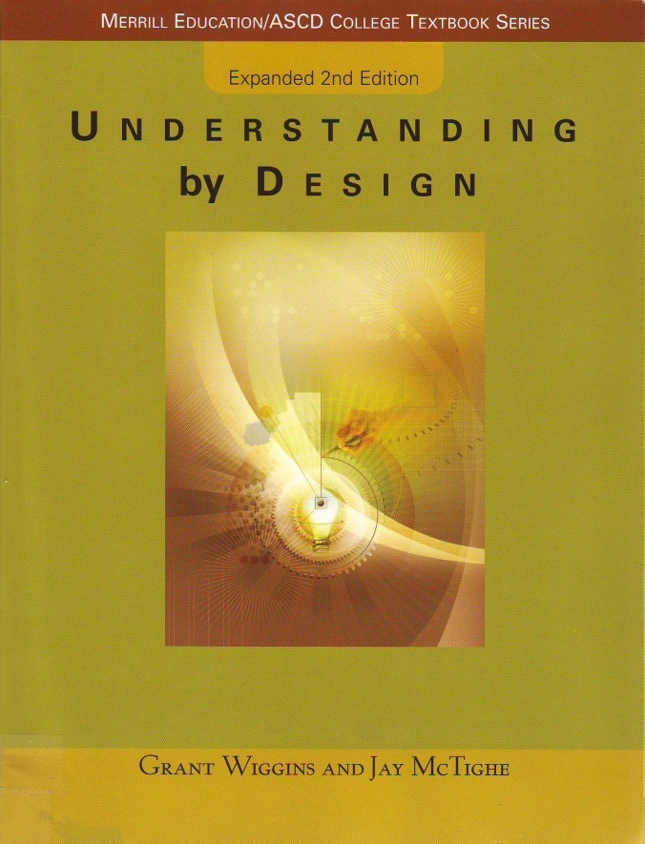
The idea of ‘backward design’
When designing a course, or teaching module
  Begin by writing a set of questions and tasks that would provide you with evidence that a student had (or had not) achieved each of the intended learning outcomes
  Only then start to plan activities and a teaching sequence to help students learn what they need to learn to do such questions and tasks.
Wiggins, G., & McTighe, J. (2006). Understanding by design, 2nd edn. Upper Saddle River, NJ: Pearson.

Slide 16
Developing teaching-learning resources

Slide 17
Developing teaching-learning resources
Usual starting point: a statement (in some form) of the required curriculum content for the target age range
  from a National Curriculum
  or a statement of standards
From this, decide on a set of topics for teaching modules

Slide 18
The York Science development process
For a given topic, write down the story we want to tell to students
Narrative
Writing the Narrative identifies the essential ideas and the links between them.
For each part of the story, say what we hope students will learn
Learning intentions
Writing Evidence of learning statements clarifies the Narrative.
List the things we want students to be able to do to provide evidence of their learning
Evidence of learning statements
Writing Evidence of learning items clarifies the Evidence of learning statements – and perhaps also the Learning intentions.
For every statement, write a question or task that could provide evidence of learning
Evidence of learning items

Slide 19
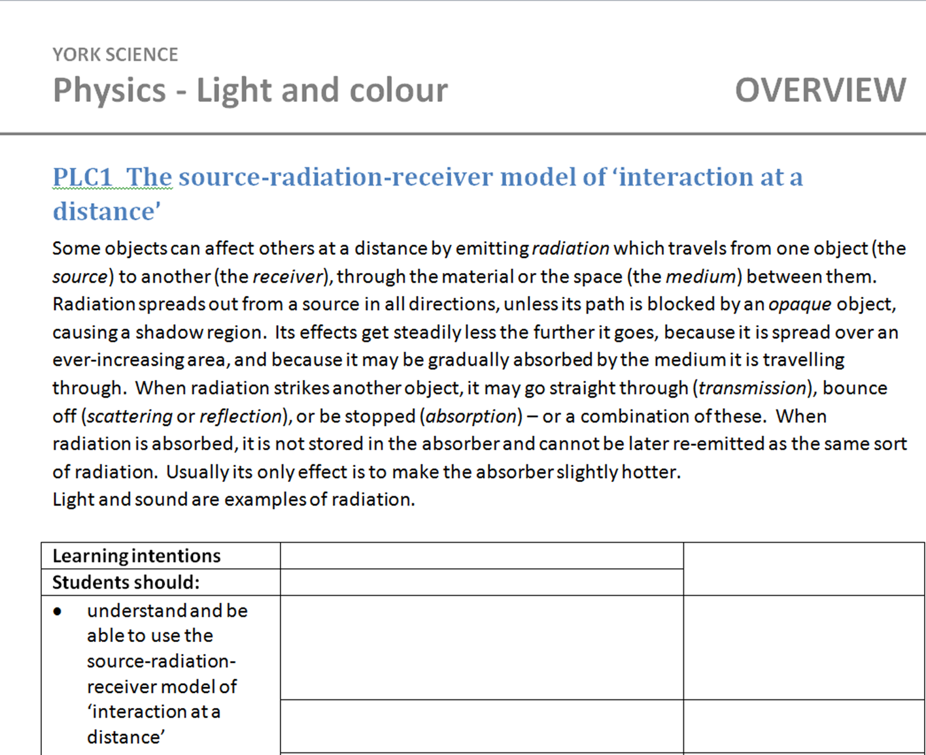
Step 1: Write the ‘narrative’
The first part of a narrative on the topic ‘Light and sound’:

Slide 20
Step 2: State the learning intention(s)

Slide 21
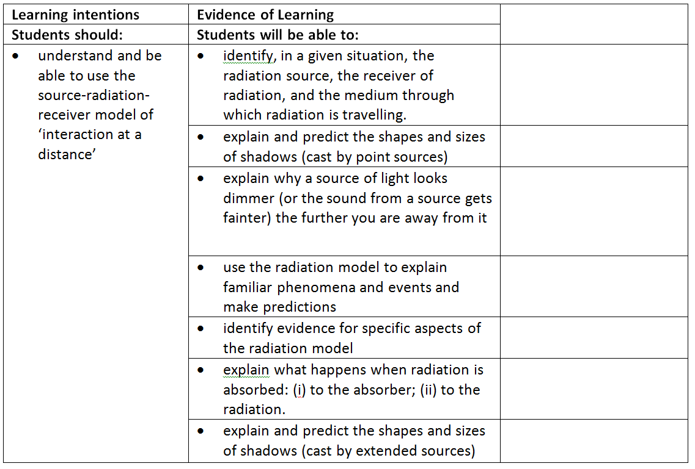
Step 3: Say what would provide evidence of learning

Slide 22
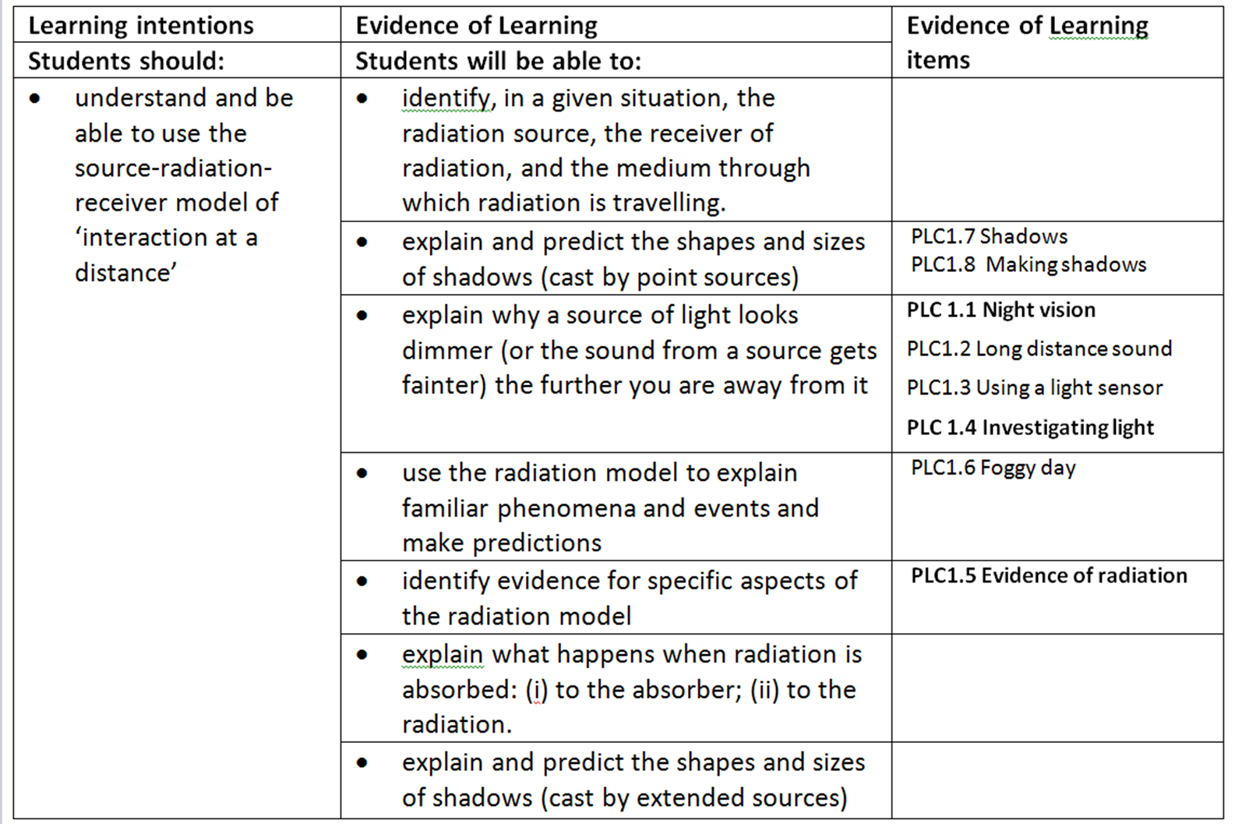
Step 4: Write questions and tasks that could provide this evidence

Slide 23
Some sample Evidence of learning items
- from a range of topics

Slide 24
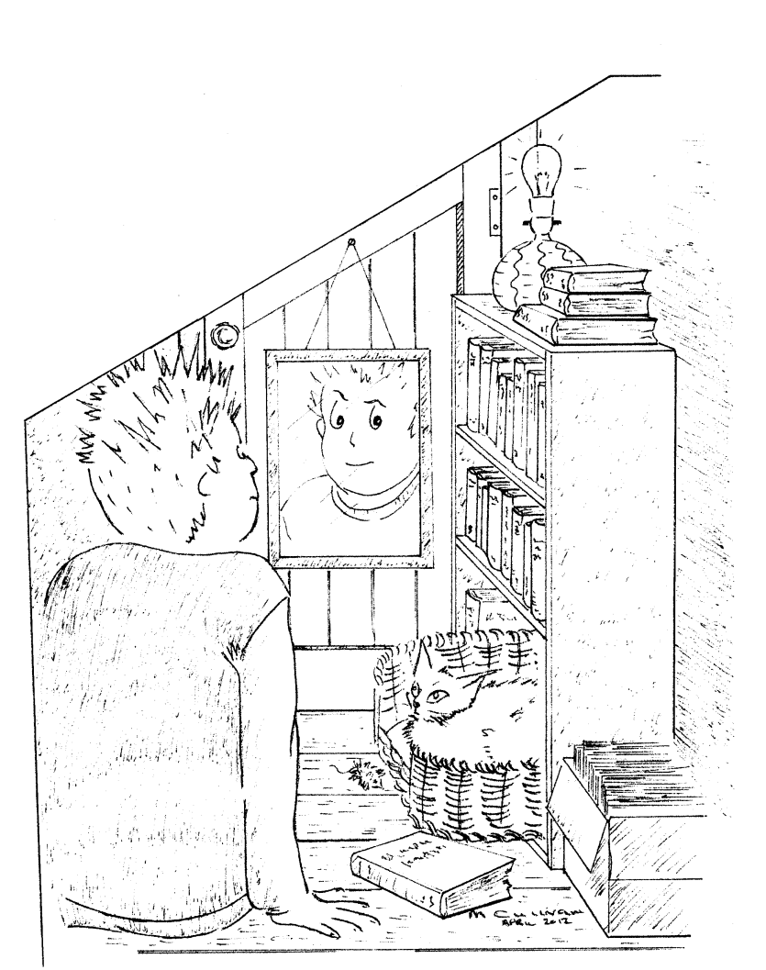
Simple multiple-choice
Imagine you go into a cupboard under the stairs and close the door. There are no windows and the door is a very tight fit.
You switch off the light.
After sitting there for a
while, what will
you be able
to see?
A After a while, you will be able to see everything, but very dim.
B The only thing you will see is the cat’s eyes shining.
C You will see the mirror shining dimly, but everything else will be dark.
D You won’t be able to see anything at all, no matter how long you wait.

Slide 25
Confidence information adds value
 | I am sure this is right | I think this is right | I think this is wrong | I am sure this is wrong
A After a while, you will be able to see everything, but very dim.
B The only thing you will see is the cat’s eyes shining.
C You will see the mirror shining dimly, but everything else will be dark
D You won’t be able to see anything at all, no matter how long you wait

Slide 26
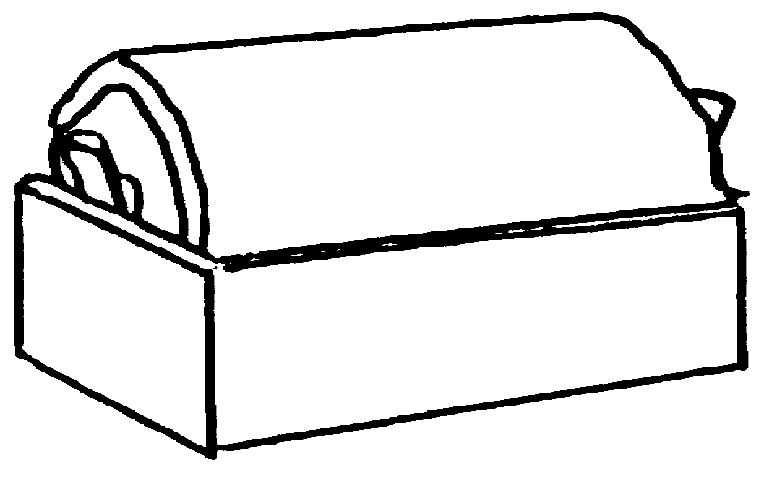

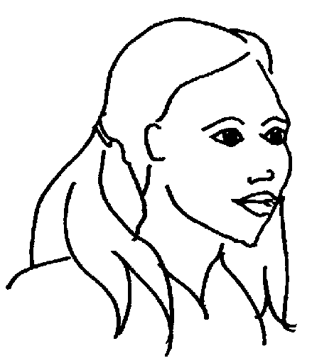
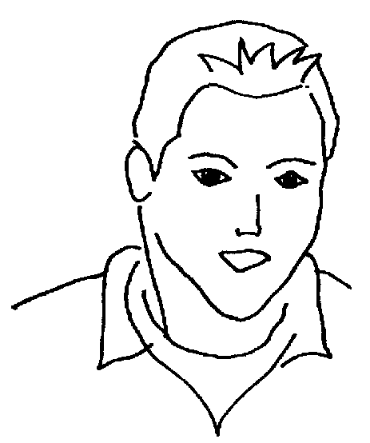
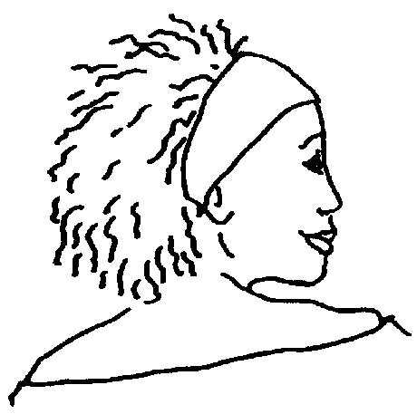
Ali: Positive and negative charges come out of the two terminals of the battery. They meet at the lamp, and this makes it light.
Multiple-choice question presented as ‘talking heads’
A 1.5V battery is connected by two wires to a torch bulb. The bulb is lit.
What is happening to make the bulb light?
Which of the students below is closest to how you imagine it?
Ben: Electric charges come out of one end of the battery, carrying energy. They travel along the wire. When they reach the bulb, they transfer their energy. The charges then travel on through the wire, back to the other end of the battery to pick up more energy.
Cath: The wires and the battery are full of electric charges all the time. They are free to move. The battery makes them all move round together. Their motion through the bulb filament makes it get hot.

Slide 27
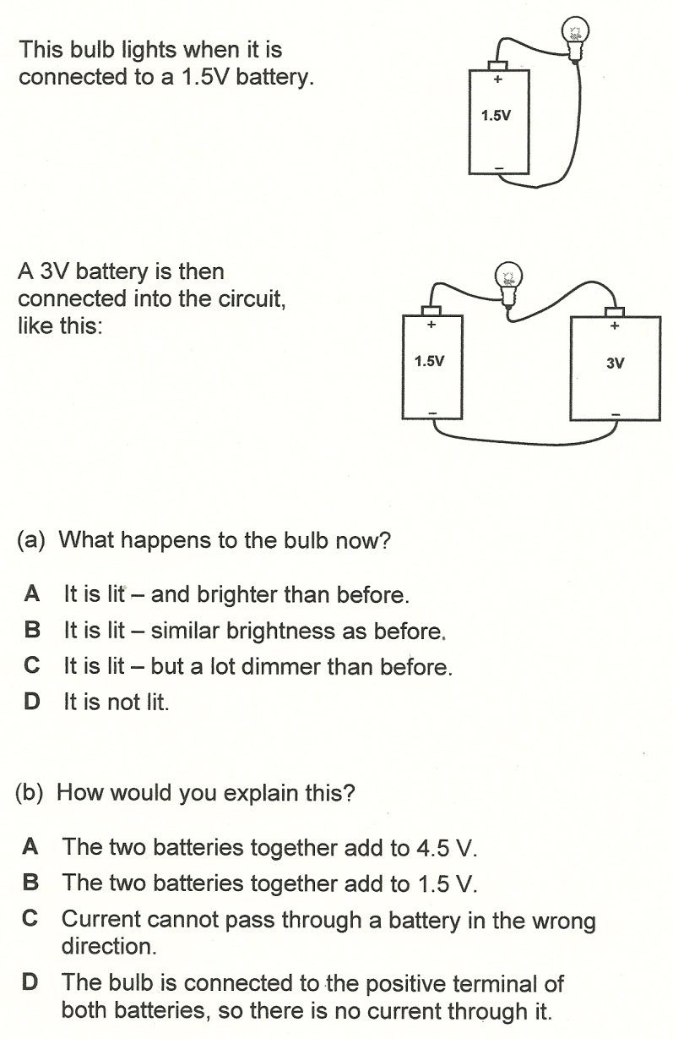
Two-tier multiple choice
Teachers report that two-tier MC questions stimulate more discussion in student groups than single-tier followed by ‘Explain your answer’.

Slide 28
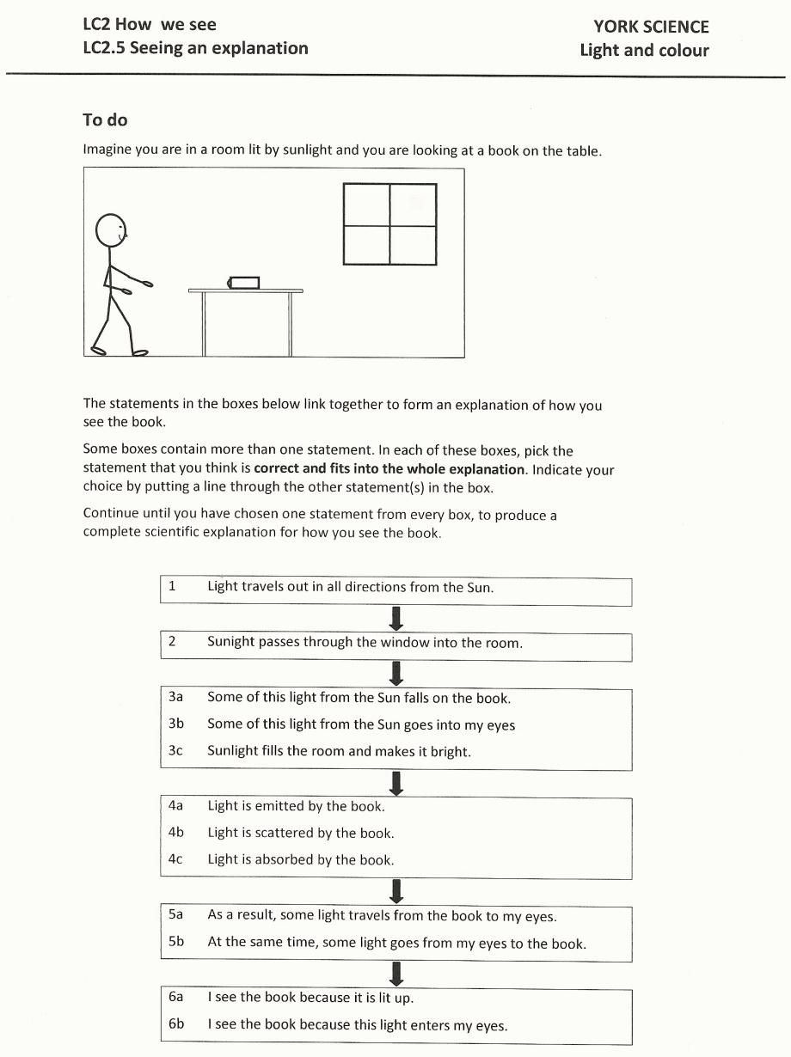
Construct an explanation
Essentially, this is a complex multiple-choice item
…. but the parts are related, so the item provides evidence of understanding of the whole ‘story’.

Slide 29
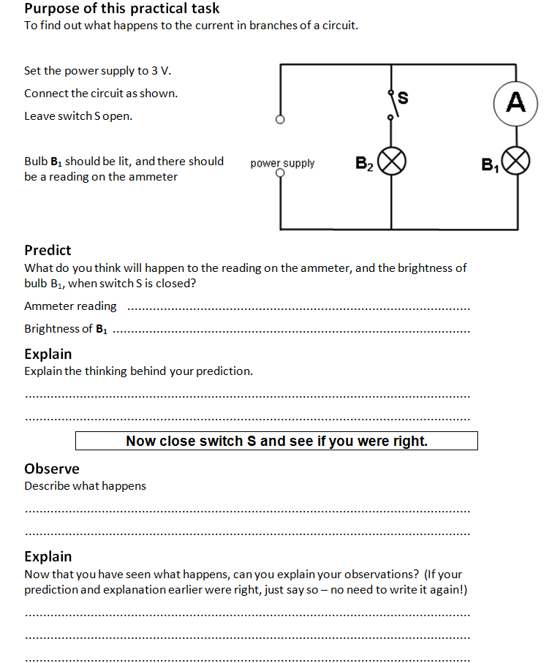
Predict-explain-observe-explain

Slide 30
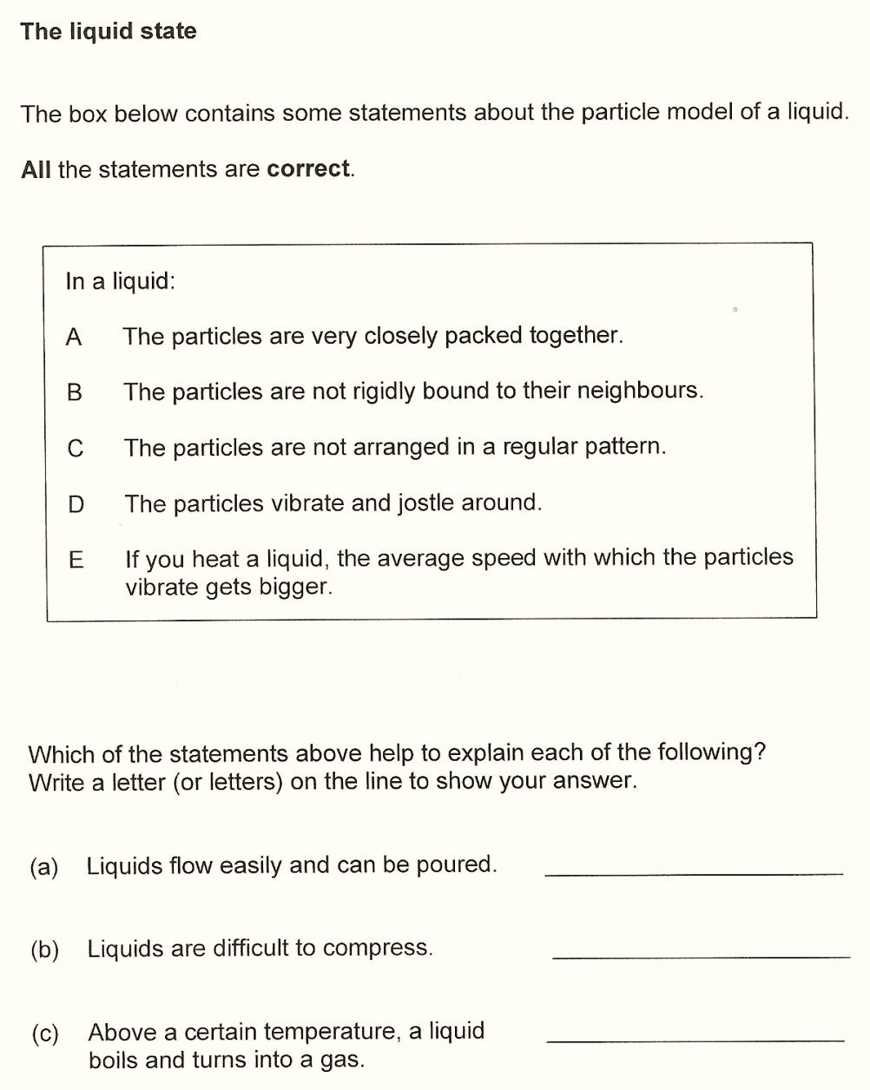
Using a model to explain observations
More complex selected-response item.
Probes students’ ability to use the particle model, not just recall it.

Slide 31
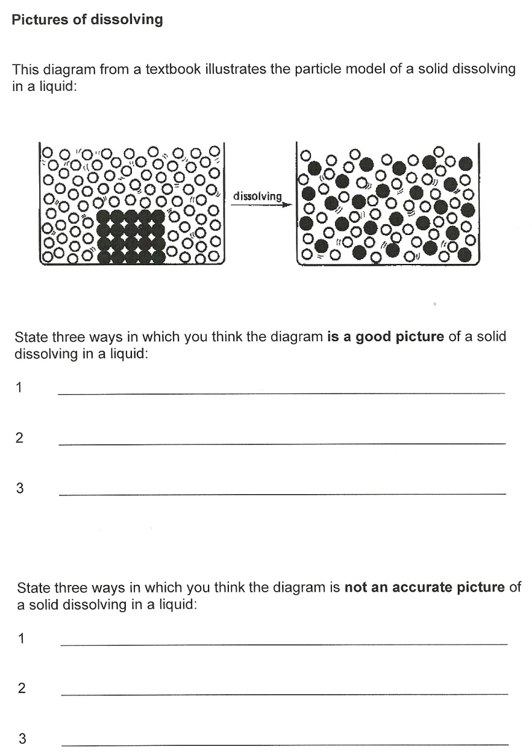
Evaluating a representation
A structured constructed-response item.
Evaluating a representation can provide evidence of students’ understanding of the model on which the representation is based.

Slide 32
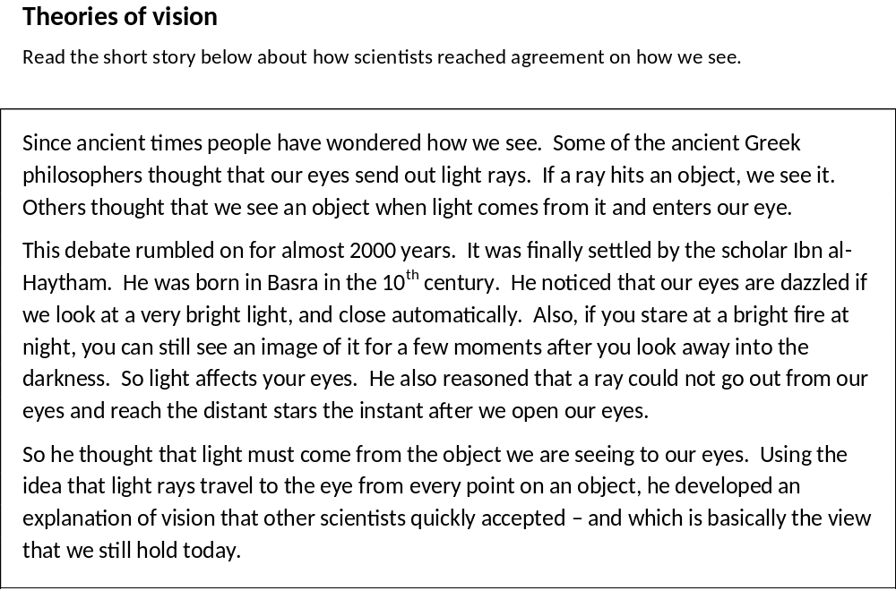
Analysing text

Slide 33
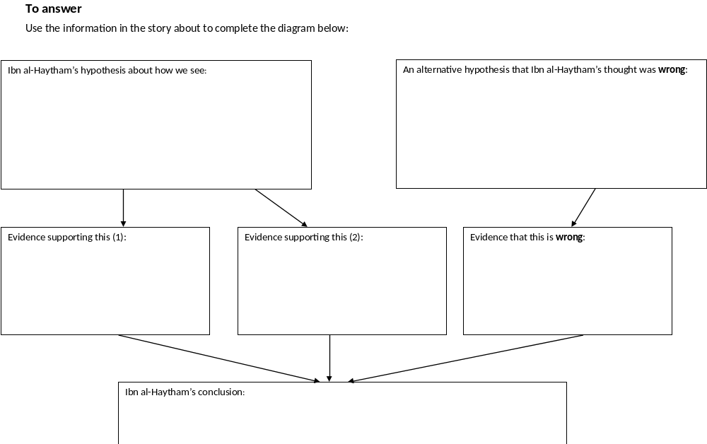
Analysing text (contd.)
Here the aim is to probe students’ understanding of the structure of a scientific argument, and their ability to use terms like ‘hypothesis’, ‘evidence’ and ‘conclusion’.

Slide 34
York Science
What we have done so far:
  Developed banks of Evidence of Learning Items for 6 science topics at lower secondary school level
  Explored how teachers use these materials, and how this influences their practice and thinking
What we are currently doing:
  Extending this to cover all of the ‘big ideas’ of science in the lower secondary curriculum
  Working with CPD colleagues to support teachers in using these resources as effectively as possible
  Supporting teachers who want to develop teaching schemes using ‘backward design’ principles

Slide 35
Evaluating impact

Slide 36
Data collection
Teachers in 45 schools each given materials for one science topic
  Pack included suggestions on ways of using these
After several months, teachers completed questionnaires
  Descriptive data (What had they used? How had they used it?)
  Evaluative data (What did they think of the materials? Any suggestions for improvement/addition?)
  Reflective data (How might this change their teaching and planning?)
Interviews with 13 teachers to explore the same issues in more depth

Slide 37
Teachers’ responses
Strongly and uniformly positive
  materials and approach seen as directly relevant to issues teachers are currently grappling with
  gave them insights into students’ thinking that lay behind their answers
Surprise at prevalence of ‘misconceptions’
  also in topics they thought they had taught successfully
Examples of development of similar items for other topics
Reflections on how they would teach the topic ‘next time round’

Slide 38
Getting unexpected feedback
“When I was given the trial pack to try it out, I was in the middle of teaching light and I though ‘Oh, I’ll try some of these, they’ll be able to do them, no problem for students.’ But they couldn’t. It was the activity about: you’re in the cupboard and the door’s closed and there’s a cat. What will the eyes of the cat look like? And they all thought the cat’s eyes would glow in the dark. They had no idea.” (T02)

Slide 39
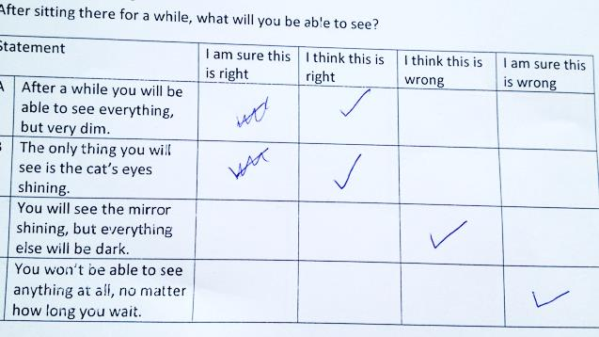
“One student got it right, the most common response by far was this”

Slide 40
Insights into students’ thinking
“I really like how I’m able to get down to the nitty-gritty of what the kids are thinking … how are they actually thinking about it” (T02)
“It makes you look at things more completely from an understanding level and also informs you on an understanding level as well.” (T09)

Slide 41
Insights into students’ thinking
“The nice thing about this, it’s multiple choice, you have various different answers, but there are some which if your thinking isn’t quite right, that’s the one you’ll go for. And that’s really really helpful and really useful. You can listen to the thought processes, they have discussions about it, what do you think, what’s this, how does this work, and that really helps you into what they’re thinking and how it works.” (T11)

Slide 42
Changing how you teach a topic
“The YS materials pick up the misconceptions in such a way that it’s clear what they don’t understand and how they don’t understand it. So it’s better than simply getting a wrong answer on a test, you’ve actually got some sort of idea about what they don’t understand and a potential way in to fix it. And it’s mainly go back to the particular lessons where I knew there was a problem and take another look at them as well. When I’ve taught it again, I’ve approached it in a different way.” (T11)

Slide 43
Evaluating teaching materials
Research so far provides
  encouragement (that providing good assessment materials can influence teachers’ practice and thinking)
  ‘proof of principle’ (materials like these can have a positive effect on classroom practices)
  some evidence that these designed teaching materials are quite likely to be used as intended (for assessment ‘in real-time, as stimuli for discussion, to inform the next steps)
How might a project like York Science be evaluated to provide stronger evidence of impact on student learning?

Slide 44
For more information
Project website: www.YorkScience.org.uk

